Slide 1

Terraform

Slide 2
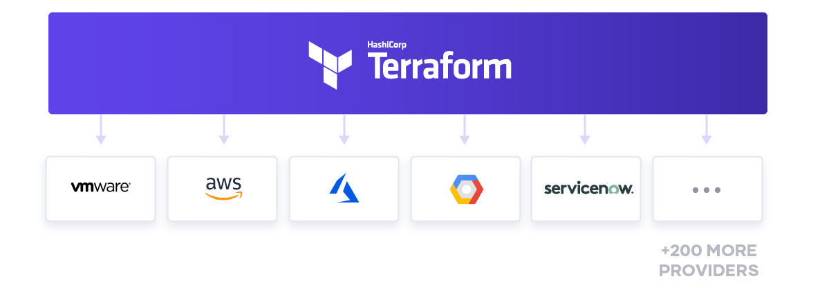
Introduction

Slide 3
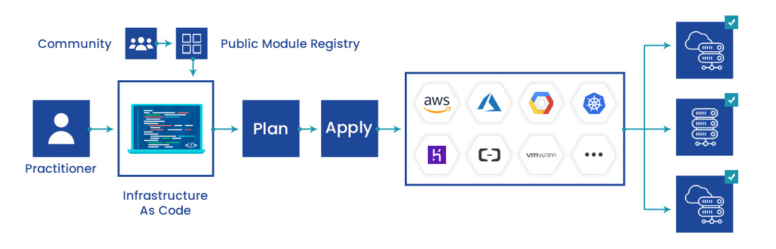
Introduction

Slide 4
What is Terraform?
Tool for
Building,
Changing, and
Versioning infrastructure safely and efficiently
Can manage
Existing and popular service providers as well as
Custom in-house solutions.

Slide 5
The key features of Terraform
Infrastructure as Code
Execution Plans
Resource Graph
Change Automation

Slide 6
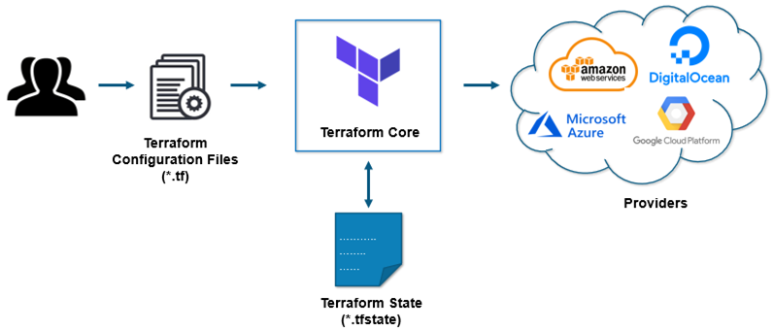
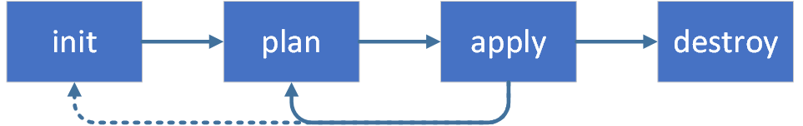
How Terraform works?

Slide 7
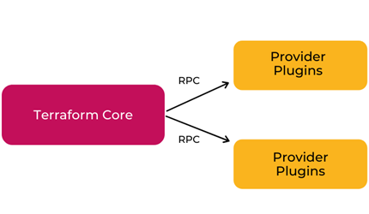
Terraform Core
Written in the Go programming language
The entry-point for anyone using Terraform
Primary responsibilities
Reading configuration files
Resource state management
Construction of the Resource Graph
Plan execution
Communication with plugins

Slide 8
Terraform Plugins
Each plugin exposes an implementation for a specific service
such as AWS, Azure
Plugin Locations
~/.terraform.d/plugins

Slide 9
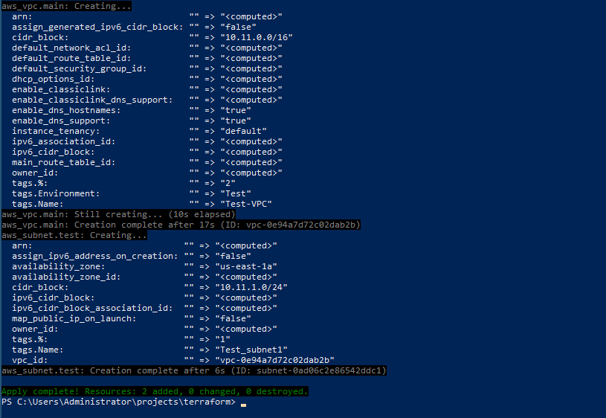
Install Terraform
curl -fsSL https://apt.releases.hashicorp.com/gpg | sudo apt-key add –
sudo apt-add-repository "deb [arch=amd64] https://apt.releases.hashicorp.com $(lsb_release -cs) main“
sudo apt-get update && sudo apt-get install terraform
terraform –help
terraform -install-autocomplete
Refer: 0-Install-Terraform.md

Slide 10
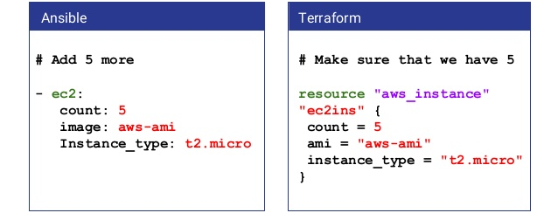
Procedural vs Declarative

Slide 11
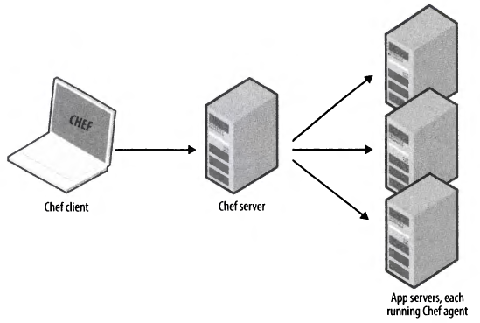
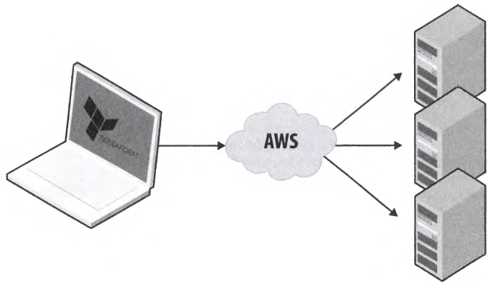
Agent vs Agentless

Slide 12
An Introduction to Terraform Syntax
Called HashiCorp Configuration Language (HCL)
Human readable as well as machine-friendly
# An AMI
variable "ami" {
description = "the AMI to use"
}
resource "aws_instance" "web" {
ami = "${var.ami}"
count = 2
connection {
user = "root"
}
}

Slide 13


Slide 14
How to create reusable infrastructure
Module basics
Module inputs
Module outputs
Versioned modules

Slide 15
Module basics
Any set of Terraform configuration files in a folder is a module.
$ tree minimal-module/
.
├── README.md
├── main.tf
├── variables.tf
├── outputs.tf
A module can call other modules

Slide 16
Calling a Child Module
module "servers" {
source = "./app-cluster"
servers = 5
}

Slide 17
Module inputs
Parameters for a Terraform module
Like function arguments
variable "image_id" {
type = string
}
variable "availability_zone_names" {
type = list(string)
default = ["us-west-1a"]
}

Slide 18
Using Input Variable Values
var.<NAME>
resource "aws_instance" "example" {
instance_type = "t2.micro"
ami = var.image_id
}

Slide 19
Variable Definitions (.tfvars) Files
To set lots of variables, it is more convenient to specify their values in a variable definitions file
And then specify that file on the command line with -var-file
terraform apply -var-file="testing.tfvars"

Slide 20
Module outputs
Like the return values of a Terraform module
output "instance_ip_addr" {
value = aws_instance.server.private_ip
}

Slide 21
Loops
resource "aws_lam_user" "example" {
count = 3
name = "neo.${count.Index}"
}

Slide 22
Getting Started & Setting Up Labs
Install Terraform
Choosing Right IDE for Terraform
- VSCode
Use AWS account

